Slide 1
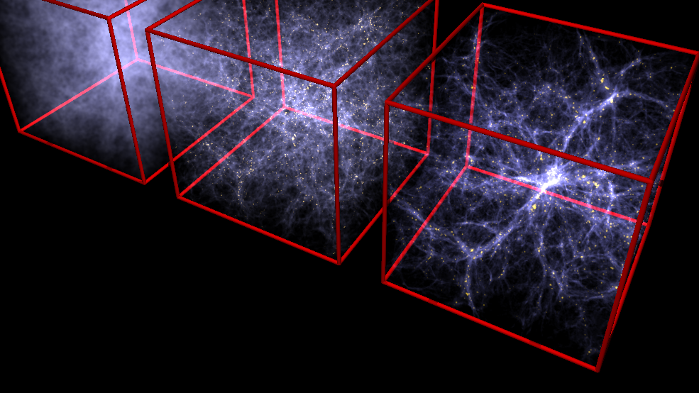
Astronomy 100 Lab 8
COVID REMINDERS: Your face mask must cover your mouth AND nose.
If you are feeling at all ill, email your instructor, and don’t come to lab unless you have gotten a negative test.
Fall 2021
https://wwwmpa.mpa-garching.mpg.de/gadget/hydrosims/sim3d.png

Slide 2
Fill out the Lab 8 pre-lab survey on Moodle.
This is the last regular lab of the semester. After this, we are only conducting makeup labs.
The schedule of makeup labs next week is on Moodle.
Monday 12:20pm: Lab 3, 1:25pm: Lab 4
Wednesday 12:20pm: Lab 5, 1:25pm: Lab 6
Friday 12:20pm: Lab 7, 1:25pm: Lab 8
You can also come to ask questions about your sunset project.

Slide 3
Sunset project: Part 2
You need 2 follow-up sunset pictures after your first one.
Your 2nd photo should be at least one week after your first.
Your 3rd photo should be at least one month after your first.
You will also need to submit Stellarium screenshots of the Sun’s position at the same times and location of all your photos, and record the azimuth and elevation data.
After you turn in your pictures you will fill out a final report on Moodle:
about your photos
comparing the Sun’s position in your photos
predicting where the Sun will set on 21 Dec (the winter solstice) on a picture.
If you are unable to get good sunset pictures, make sure to upload your attempts.
Due date: Wed, 1 Dec 2021

Slide 4
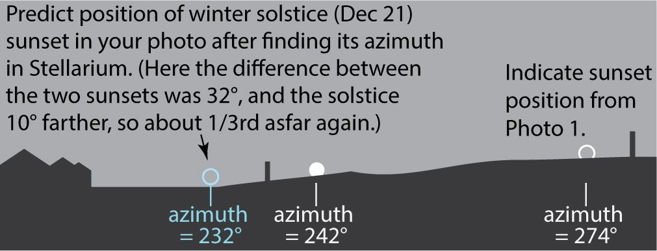
Sunset project: Final Report
Submit a marked-up picture showing how the Sun moved and how you expect it to shift to 21 Dec.
Compare it to your grid picture to show that the scale is about right.

Slide 5
Extra credit Moon project
Take a picture of the Moon during the daytime.
Take a picture of the Moon with the camera zoomed all the way OUT.
Include the horizon or some other object level with you. This can be done with your camera vertical (i.e. portrait mode).
Take a second picture of the Moon with the camera zoomed all the way IN.
When you turn in the project, you will also need to get a Stellarium screenshot of the Moon from the same time and place, so make sure you record those.

Slide 6
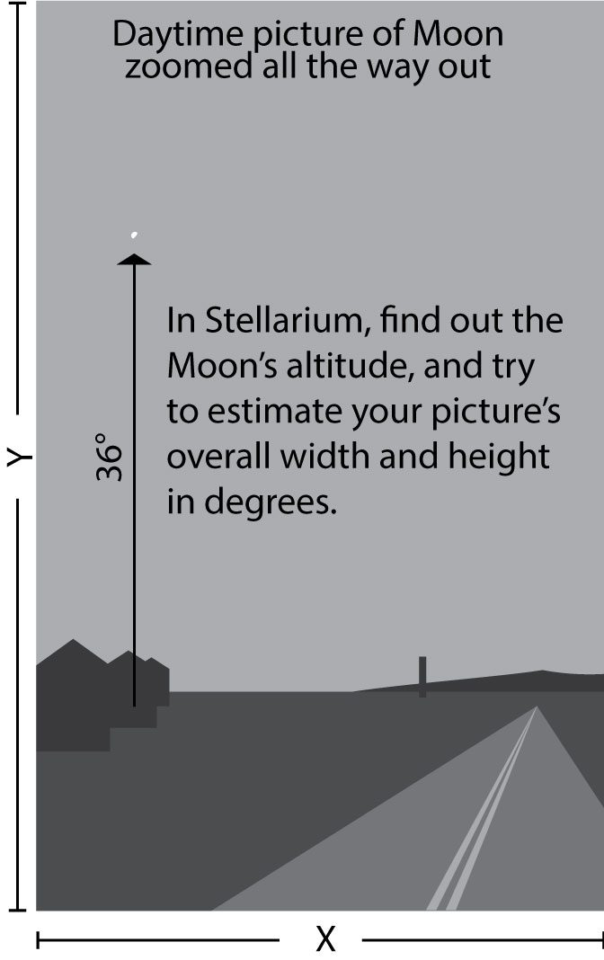
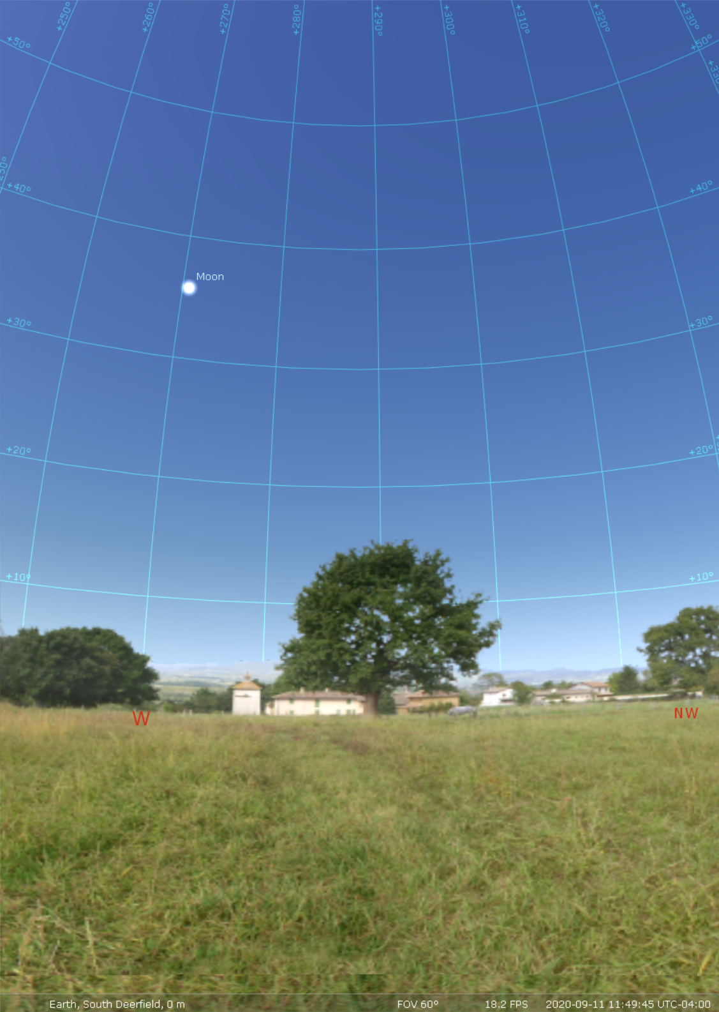

Slide 7

Tempus fugit…
Sunset project deadline: Wed 1 Dec 2021
Moon extra credit project deadline: Mon 29 Nov 2021

Slide 8
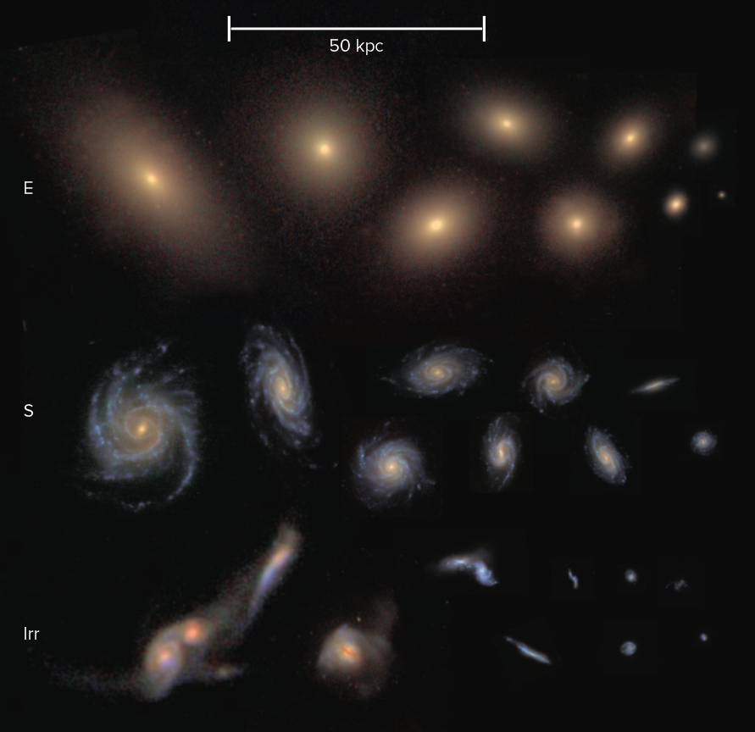
Part 1: Sizes of galaxies
Galaxies come in three major classes: Ellipticals, Spirals, and Irregulars.
They can look similar yet be very different sizes.
A distant galaxy with a small angular size may be physically larger than a nearby galaxy with a large angular size.
(SDSS image compilation--S.E.Schneider)

Slide 9
Part 1: Sizes of galaxies – The Local Group
We have a complete census of galaxies only for those relatively nearby our own Galaxy, the Milky Way.
Some are so faint and the stars so spread out that they’ve only been identified in the last decade.
This is similar to how we only see the dimmest stars near the Sun.
When we plot all the nearby galaxies, we find that the Milky Way is part of a cluster of several dozen galaxies that make up what is called the Local Group.
We will use the angular sizes and distances of these galaxies to find their sizes.

Slide 10
Part 1: Sizes of galaxies
Work in pairs. On Moodle, go to the Galaxy Data Sign-up link for this lab and fill out your pair’s names at the next available galaxy.
Have one person stand at a distance of: galaxy distance/500,000 light-years in meters from the whiteboard, i.e. 2 m for 1 million (1,000,000) light-years.
Have the other person stand at the whiteboard and mark out a width that corresponds to 2 degrees of angular width as seen by the first person.
This is about the width of your thumbnail with your arm fully held out in front of you.
Trade places and repeat to check for consistency.
Using this scale, mark out the size of your chosen galaxy as estimated from its observed angular size.
e.g. If your galaxy is 0.1 degrees across, it will occupy 0.1/2 of the width you marked out.
Using the same scale of 500,000 light-years per meter, estimate the true size of your galaxy.

Slide 11
Part 1: Sizes of galaxies
Use the following colours to denote galaxy type:
E (elliptical)/Sph (spherical): Yellow
S (spiral) (a-m): Green
Irr (irregular): Blue
If your galaxy is small enough to fit on your slip of paper, draw it on your paper as a circle of the correct size and colour it in with the right color.
If your galaxy is too big to fit on your paper, get a piece of coloured paper of the right colour and cut out a circle of the correct size to attach to your paper.

Slide 12
Part 2: Structure of the Local Group
Galaxies in the Local Group mostly lie on a fairly flat plane, so we have assigned them an azimuth according to the direction they lie from the Milky Way.
Using the position of the Milky Way we have put up, and looking at the following diagram, find the direction of your galaxy relative to the Milky Way.
In that direction, go out the corresponding distance of your galaxy from the Milky Way, and put it down. Mark the position on your worksheet.
Remember that the scale is 500,000 light-years per meter.

Slide 13
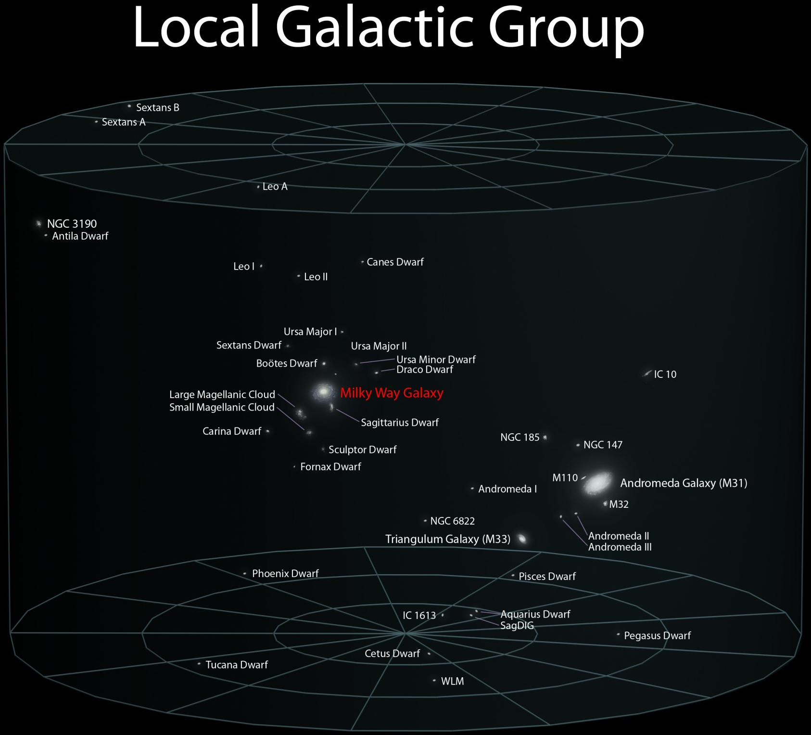
Most galaxies are small (“dwarfs”) and are members of clusters that range from a few bright galaxies to tens of thousands of them.
The large galaxies in the Local Group are spirals, but in larger clusters, the big galaxies are mostly ellipticals.
https://www.sun.org/uploads/images/Local_Group.jpg

Slide 14
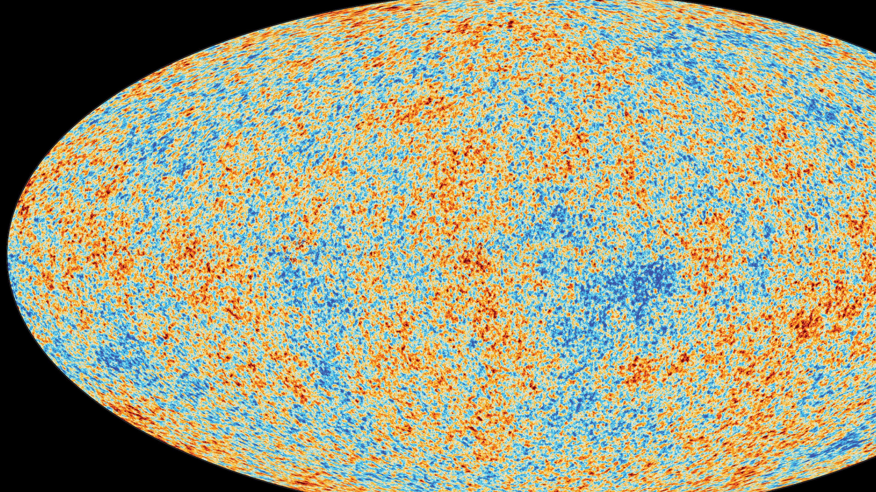
To infinity and beyond!
Fill out the end-of-lab quiz on Moodle before leaving.
If you have time, do the Astronomy Survey as well. The survey will remain open for a week if you don’t have time to do it now. It is only scored for completeness, not for whether your answers are correct.

